Slide 1

Zowe Community 20PI3 Squad Focus

Slide 2
Notes
Before this presentation ZLC will present Zowe achievements from last PI and context/vision at a hill-level for the upcoming PI
Following this presentation, the squads will disperse into breakouts to plan their PI in more detail

Slide 3
Agenda
API ML Squad Focus
App Framework Squad Focus
CLI Squad Focus
Zowe Explorer Squad Focus
Onboarding Squad Focus
Systems Squad Focus
“Deployments” Working Group Focus
Doc Squad Focus

Slide 4
API ML Squad Focus
Elliot Jalley (Squad Lead)

Slide 5
Dependencies
Systems Squad – ‘Design Zowe HA Infrastructure’

Slide 6
Feature 1
x.509 client certificate authentication support for API Mediation Layer
(in support of SECURITY theme)
As a system admin / security admin, I want to allow Zowe users and client applications (such as Zowe clients and custom applications) to authenticate with Zowe API ML using client certificates (x.509) which are industry-proven as more secure than credential authentication.
Deliverable: Zowe API ML can validate client certificates by using ESM to map the certificate with the user mainframe identity and issue a JWT.
Notes:
Notes:
x.509 is one of the industry standard ways of authenticating to backend services
Zowe Client apps will need to be updated to support client certs
Customer apps may have their own way of supporting client certs

Slide 7
Feature 2
Remove the dependency of APIML on z/OSMF for authentication and use SAF to obtain the JWT
(in support of SECURITY theme)
As a system admin / security admin, I want a configurable option at installation of Zowe to use SAF as my authentication provider, thereby eliminating the pre-requisite on z/OSMF, and removing a barrier to my adoption.
Deliverable: Instead of a call to z/OSMF, Zowe API ML will use SAF APIs to verify credentials. This will be implemented as an additional provider, the z/OSMF authentication provider will remain the default.
Notes:
Zowe APIML currently depends on z/OSMF to be installed in the same security domain for authentication.
There are use cases where just APIML is needed on some systems and there is z/OSMF on other systems or any system in the same security domain.
This is a request to:
Remove the dependency of APIML on z/OSMF for authentication and use SAF to obtain the JWT
This will be implemented as a different provider, the z/OSMF authentication provider will remain the default
z/OSMF will not be accessible via API ML if z/OSMF will not trust SAF JWT
Update the installation process to allow this option

Slide 8
Feature 3
Support for high availability / sysplex distributor in API Mediation Layer
(in support of RESILIENCE theme)
As an API consumer, I’m able to rely on API routing by Zowe API ML with an expectation of 24/7 SLA.
Deliverable: The usage of Dynamic Virtual IP Address (DVIPA) will ensure that if an instance of Gateway and/or Discovery fails on one system (LPAR1), the other system (LPAR2) continues to provide service functionality through a sysplex distributor.
Dependency: Systems Squad – ‘Design Zowe HA Infrastructure’
Notes:
Config, Doc, testing for CICD squad.

Slide 9
App Framework Squad Focus
Sean Grady (Squad Lead)

Slide 10
Feature: High Availability for App Server, ZSS
Surveys show that production use desires HA for server components
Many with a sysplex or more
Results also lean away from leveraging DB2 as a state manager
Goal: Maintain usability of REST APIs and websites in the event of one or more redundant server crashes
Strive to do this without complicating configuration, including prereqs
Plan
Servers that are stateless should only need Sysplex Distributor, APIML... may not be true of app server, zss, as caching & plugins could have state
App server to find copies through APIML, implement leader election algorithm for failover
ZSS to do same, but must first become a eureka client

Slide 11
Feature: Improved Package Management for Apps
Goals:
Administrators have one tool to see, manage, upgrade, and install apps in each Zowe instance.
Tooling has dependency checks to simplify install process
At first, access tool via 3270 or SSH, to reduce learning curve
Maintain separation between backing technology and tool usability, to future-proof Zowe
Tie-in with lifecycle management scripting: standardized package layout to simplify server lifecycling

Slide 12
Feature: Improved lifecycle scripting
Goals:
Improve startup, shutdown, and status reporting of Zowe instance, its components, and apps, to simplify administration and maintenance
Strategy: Work with CUPIDS-like team to ensure app framework adheres to agreed upon scripting & structure
New scripting hooks: upgrade, stop, uninstall, status?

Slide 13
Feature: Beta download of Zowe in Docker
Surveys show Zowe adoption among ISVs limited by zOS access. Also show production use limited by capacity & cost concerns
Among container technologies, Docker on Intel Linux voted most desired, starting there but will branch out.
Goals:
Provide option to download Zowe server components within a Docker image, but containing same code as PAX and SMPE releases, so that barriers against using Zowe are reduced.
Do not complicate the configuration: Keep it easy to...
Connect the servers to z/osmf, zss, which remain on z/os
Have correct & secure certificates
Use external services, plugins, apps, without modifying docker

Slide 14
Collaboration, research focus
Doc squad: has some ideas on streamlining zowe.org... can our web devs help?
Mobile incubation: Produce PoCs around ways for traditional mobile apps to work in Desktop, and how Desktop apps can be mobile apps, with little-to-no specialized/modified code
Web Explorers + Desktop Editor: may have time to make progress on convergence
CICD: provide assistance with efforts to find and act upon performance metrics?

Slide 15
CLI Squad Focus
Mike Bauer (Squad Lead)

Slide 16
Feature 1
Zowe consumers can begin building apps and/or custom automation within hours by readily finding and leveraging Zowe SDKs, API documentation, and samples Deliverables: Documentation is published on our Zowe Docs site covering the overview and use of the SDKs as well as documenting how the community can contribute to the technology. In addition, detailed samples that leverage the SDKs are provided within each repository. To further drive visibility and adoption, the Zowe Node SDK packages are published to public npm separate from the Zowe CLI.

Slide 17
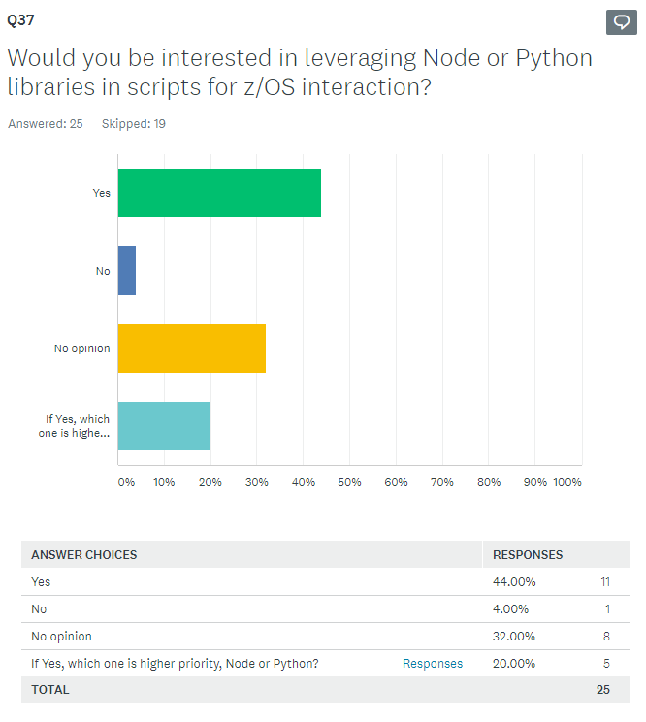
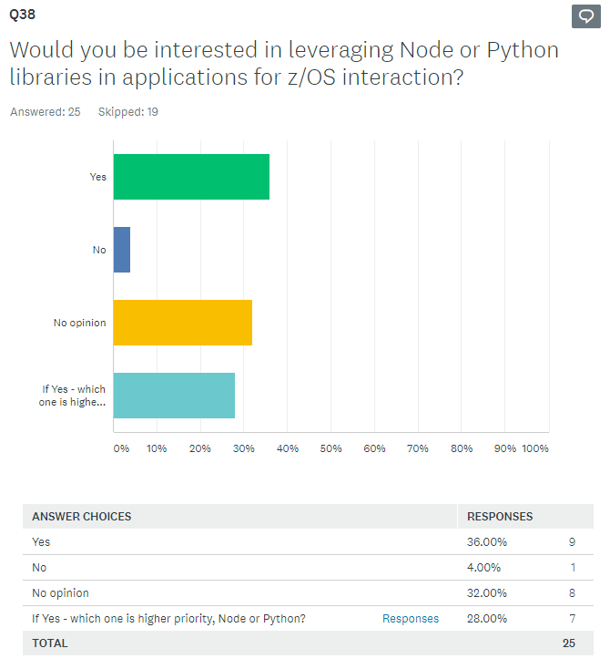
Community Feedback

Slide 18
Feature 2
Zowe CLI users can store all connection details and command option preferences in a single profile allowing for quick initial configuration and reduced effort when updating properties.
Deliverable: Simplified profile management by allowing all profile options to be specified in a single base profile. This is an enhancement to the core CLI.

Slide 19
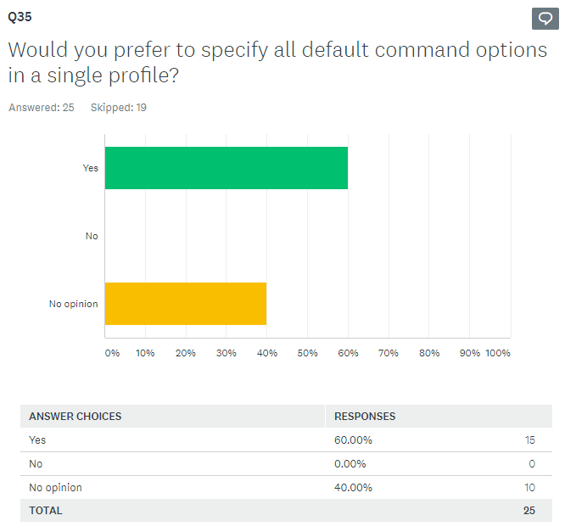
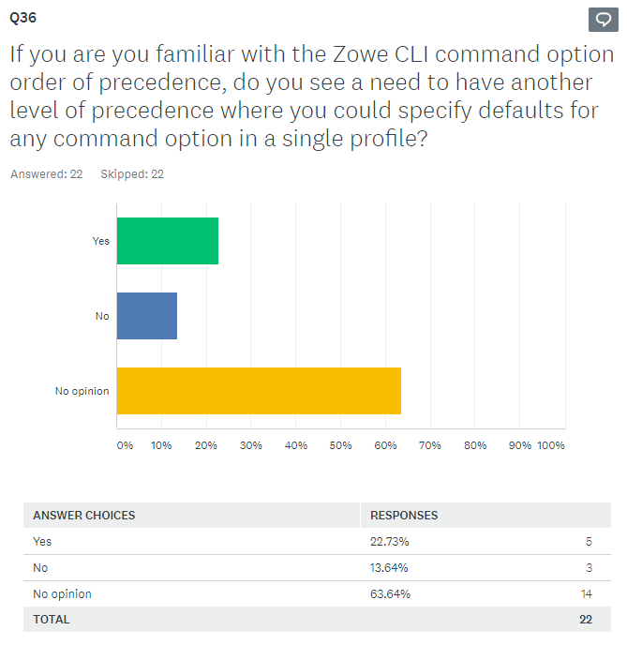
Community Feedback

Slide 20
Zowe Explorer Squad Focus
Fernando Rijo Cedeno (Squad Lead)

Slide 21
Features
Define and develop a set of conformance guidelines to be consumed by extenders of the Zowe Explorer. #837
To deliver standardized guidelines that Extenders of the Zowe Explorer can follow in order to leverage and grow the Zowe ecosystem
Leverage the Zowe CLI security enhancements around MFA and SSO for an improved security experience in the Zowe Explorer.
To increase user confidence knowing that the extension implements best security practices in order to remain compliant with corporate policies.

Slide 22
Features
Enhance the profile management user experience of Zowe Explorer (for new and regular users) (Epic) (Issues)
To deliver a greater experience when configuring and managing connection details by addressing community related issues around profiles.
Enhance the z/OS Unix user experience of Zowe Explorer (Epic) (Issues)
To deliver a greater experience when working with z/OS Unix by addressing community related issues.
Enhance the Dataset manipulation user experience of the Zowe Explorer
To deliver a customized experience for creating datasets so that users can specify desired allocation details.

Slide 23
Dependencies
CLI Squad – collaborate on APIs and/or SDK enhancements for our dataset creation objective to leverage z/OSMF’s “LIKE” capabilities.
CLI Squad – collaborate in order to successfully integrate with the security improvements and best practices (e.g. Token-auth, SSO)

Slide 24
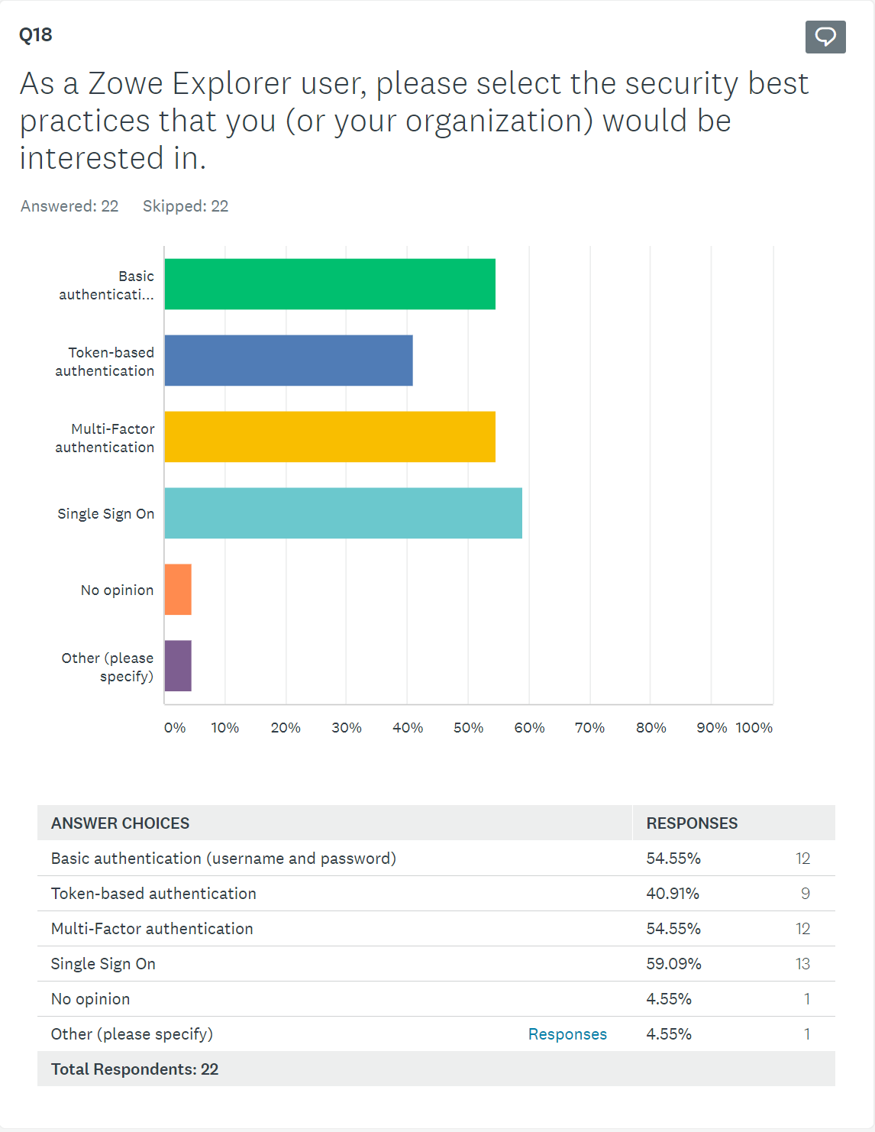
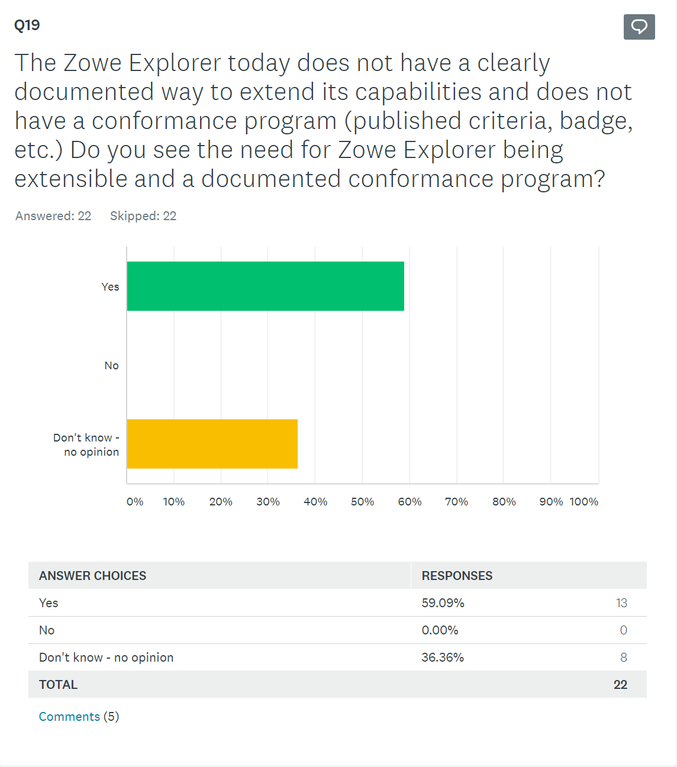
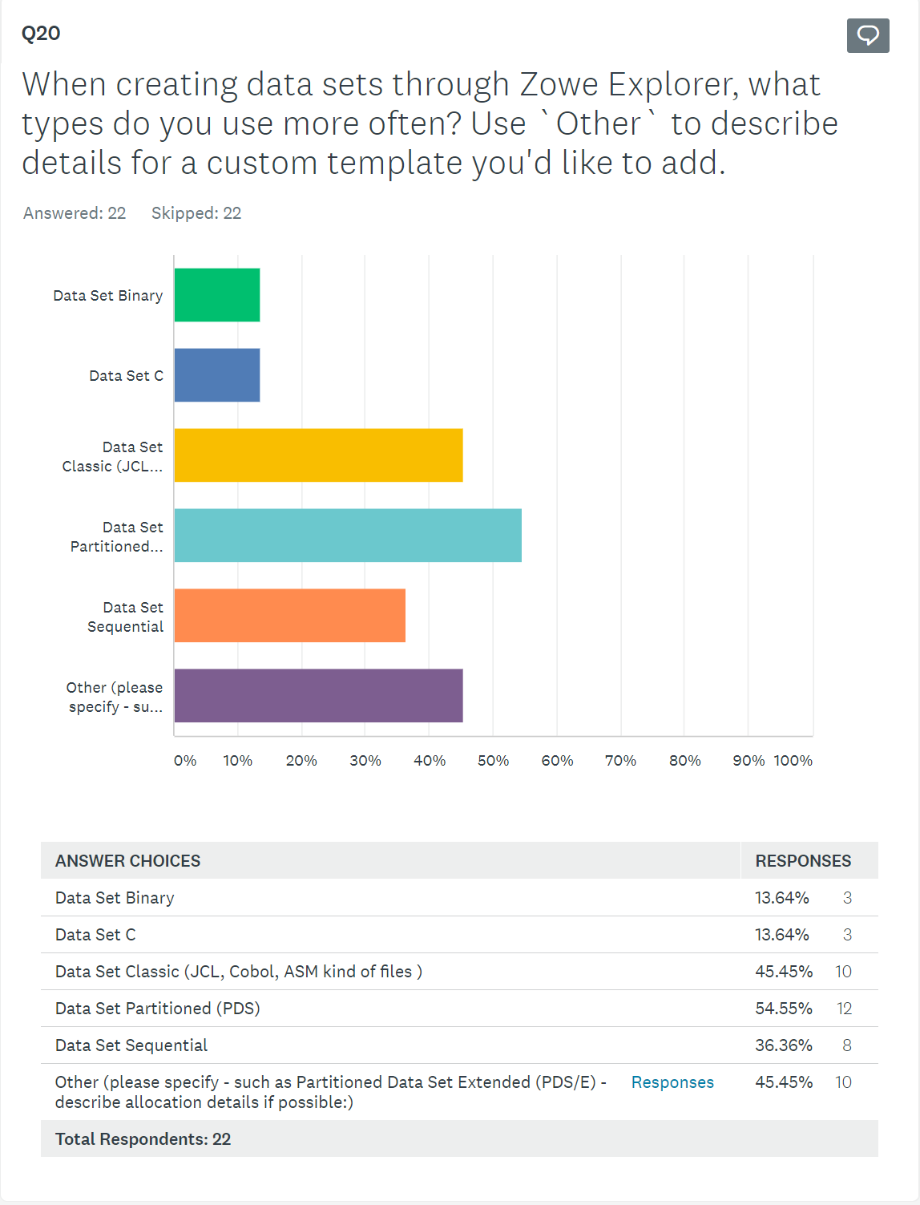
Community Feedback

Slide 25
Onboarding Squad Focus
Rose?? Joe W? (Squad Lead??)

Slide 26
Focus
Further Conformance Process Maturity
Active LTS conformance test criteria updates / incremental badging / app-store-like landscape page
Active LTS conformance change requests (test criteria & submitter form)
Increase focus on Outreach
Webinars & Marketing
Improve Onboarding experience
Improve/influence Zowe.org website navigation
Accurately “direct” new-to-Zowe visitors
Continue and transition stat reporting (KPI-centric)
Identify trends & influencers
Easy prep for all Zowe Communications
Notes:
Leverage new UX members / design thinking / persona identification Onboarding New Members

Slide 27
Systems Squad Focus
Mark Ackert (Squad Lead)
f.k.a. CI/CD Squad

Slide 28
Dependencies
Other squads may use the performance test framework to design and run their own test cases. (This doesn’t affect our PI3 deliverables.)
Work closely with APIML/Web UI squads related to High Availability / SYSPLEX.

Slide 29
Focus
Expand system testing in the community
Component integration testing on Marist systems
Zowe “release” smoke and integration testing
Build out Zowe “release” Performance Testing
Standardize infrastructure and tooling, extensible code-base for squad contribution
Continue Zowe Release activities and improvements
Second Nightly “Stable” Build
Design Zowe HA Infrastructure

Slide 30
Performance Test – scenario I
As Zowe contributors, we want to know release to release performance changes.
Deliverable:
Provide release to release comparison report.
The report should be able to provide common performance metrics including CPU, memory and I/O rates, paging rates on server side and API requests per seconds, error rates, etc.
Drive continuous testing on performance in consistent / repeatable / automated fashion.
Provide a simple way to define performance test cases which should be portable and extendible. Developers can easily customize the existing test cases, creating new and run them on any z/OS systems.
Notes:
To gather reliable test result, ideally we need dedicated hardware to run the performance test.

Slide 31
Performance Test – scenario II
As a z/OS system programmer, I would like to be able to estimate the cost of running Zowe, and fine tune my Zowe performance based on my estimated workload.
Estimated workload at first refers to concurrent user count.
Deliverable:
Deliver a tool users can run to provide them with a performance and cost estimation report.
Provide a way to aggregate accurate z/OS resource for Zowe usage from SMF 30 record.

Slide 32
High Availability / Resilience
As a z/OS system programmer I can configure Zowe z/OS Components to deliver its services through a Highly Available endpoint, using familiar practices and technology.
As a z/OS system programmer I an able to use familiar console automation offering to run, configure, and monitor Zowe z/OS components.
Deliverable:
Provide configuration guidance (including pre-req changes) to achieve HA / load balancing with APIML or SYSPLEX Distributor.
Investigation routes:
HA / Load balancing via APIML
HA / Load balancing via SYSPLEX Distributor
Notes:
Notes:
We have identified many investigation / research items to support HA, we may only achieve part of the deliverables.
To support SYSPLEX test, will need to find resource either from Marist or internal. The systems in SYSPLEX should be real LPAR to get the accurate measurement.

Slide 33
“Deployments” Working Group Focus
Steven Horsman, Joe Winchester, Sean Grady contributing
f.k.a. CUPIDs

Slide 34
Focus
Design and Begin Deployment, Packaging and Management Hill [Steve, Joe]
Improve both Zowe administrator and Zowe extender user experiences when developing and deploying Zowe extensions by streamlining packaging, install, upgrade, and configuration.
Unify existing Zowe core components and extensions with the new extension design and rebuild documentation
Scope of changes dependent on available resource and design validation
This may shift into v2 if breaking changes are required
Research and POC containerization of Zowe. [Sean]
Initially targeted for developers

Slide 35
Dependencies
Cross squad:
If we get around to the de-coupling of the existing zowe core components, then some assistance in migrating current install scripts out of zowe-install-packaging maybe be required
Other dependencies:
Access to extender and installers to validate the design
Sample spring boot rest api and sample node api to extend/use as the base for the packaging and deployment samples

Slide 36
Doc Squad Focus
Ashley Li (Squad Lead)

Slide 37
Dependencies
All squads – New feature content
Onboarding squad – Collaborate on zowe.org design and better navigation

Slide 38
Focus
Create and publish content for different Zowe components.
Allow users to browse doc by area of interest, user role, and skill level.
Provide better contribution doc about contributing to doc and code.
Improve release notes by automating its generation from CHANGELOGs and providing better business value.
Contribute to the Zowe.org website design enhancement.
Provide and consolidate more multi-media and visual content (videos, interactive graphics, diagrams).
Identify content gaps and improvement areas by leveraging content analytics.

